Slide 1
IPL Analysis
By Akshay Kishor

Slide 2





Contents
Team Performance Analysis
Squad Needs & Gaps
Player Insights & Shortlist
Player Recommendations

Slide 3

Problem Statement
Year Wise Performance of RCB
Players to be retained before auction
Players to look out for in auction
Area of improvement

Slide 4
Data Overview
ball_by_ball_with_season
Match_id: Unique identifier for a cricket match
Over_id: Unique identifier for an over in a cricket match
Ball_id: Unique identifier for a ball in an over
Innings_No: The innings number in a cricket match
Team_Batting: The team batting in a particular innings
Team_Bowling: The team bowling in a particular innings
Striker_Batting_Position: The batting position of the striker batsman
Striker: The batsman currently on strike
Non_Striker: The batsman currently at the non-striker's end
Bowler: The bowler bowling the current delivery
Runs_Scored: Run Scored by the Striker
Player_out: The Striker who is out
Wicket_type: The category of wicket
Season_id: Represent the Season Number
Venue_id: Mentions the Venue id where match is played
Match_Winner: Team who won the match
In this project I have created a view “ball_by_ball_with_season” by joining multiple tables of the source data and most of my project’s solution is taken from this view

Slide 5
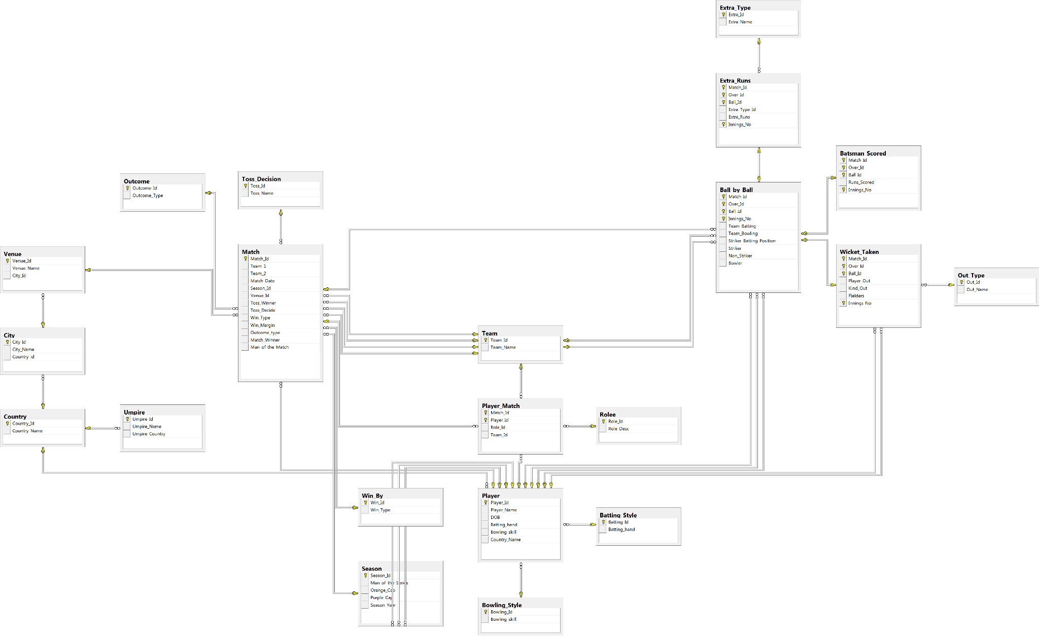
Data Schema

Slide 6
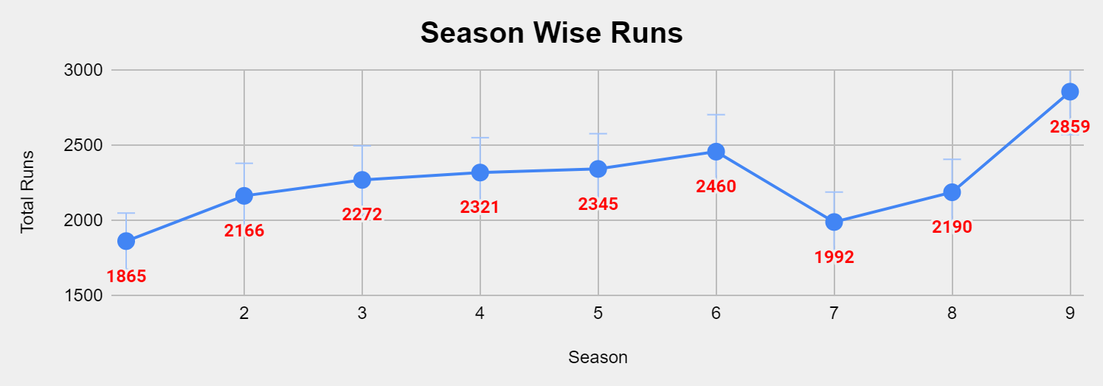
Team Performance Analysis
Season Wise Runs have increased but there is not a consistent growth
Season Wise Wickets have increased but there is not a consistent growth

Slide 7
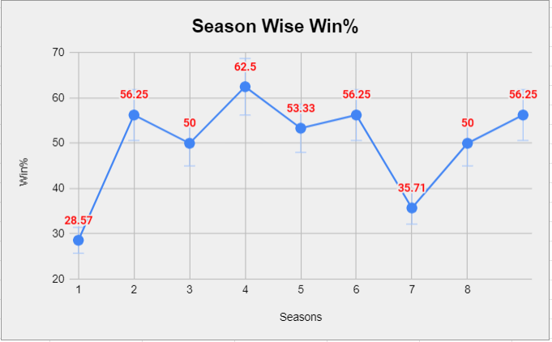
Season Wise Win%
Our Win% has crossed 60% mark only once – in Season 4 – and we entered the finals that year
We should focus on keeping our win% above 60%

Slide 8
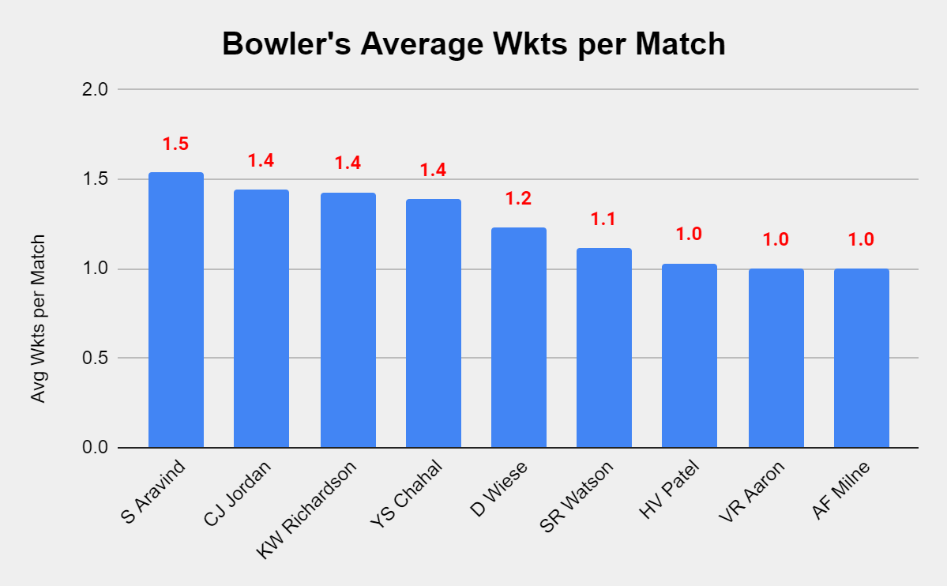
Squad Needs & Gaps
Bowler Analysis
In our current team one of our weakness is the bowling.
As it can be seen in the chat that in our current squad there is not a single bowlers with 2 wickets per match average

Slide 9
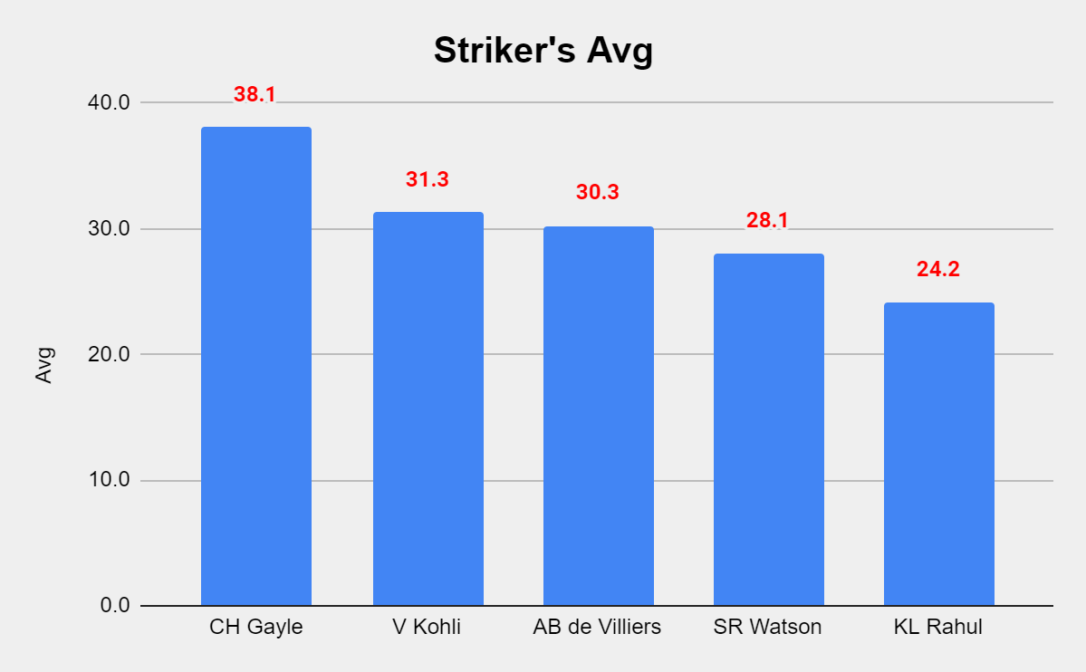
Squad Needs & Gaps
Batsman Analysis
Batsman are having good average – C Gayle is nearly 40 and is contributing highly.
V Kohli and AB de Villiers are also crossing the 30 mark

Slide 10
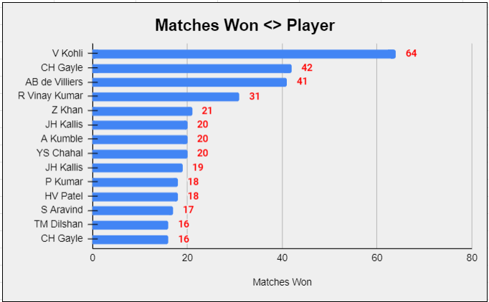
Player Insights & Shortlist
List of players in the team who have encouraged the morale and contributed in winning reigns
V Kohli, C Gayle and AB De Villiers are leading this chart.

Slide 11
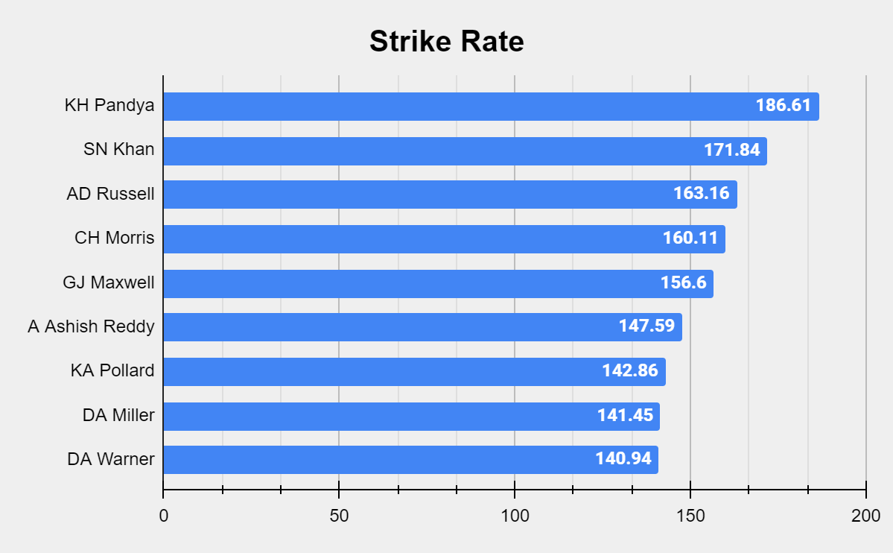
Player Recommendation
(Strike Rate)
Players with good strike rate who can be brought in auction
This would strengthen our middle order batting attack

Slide 12
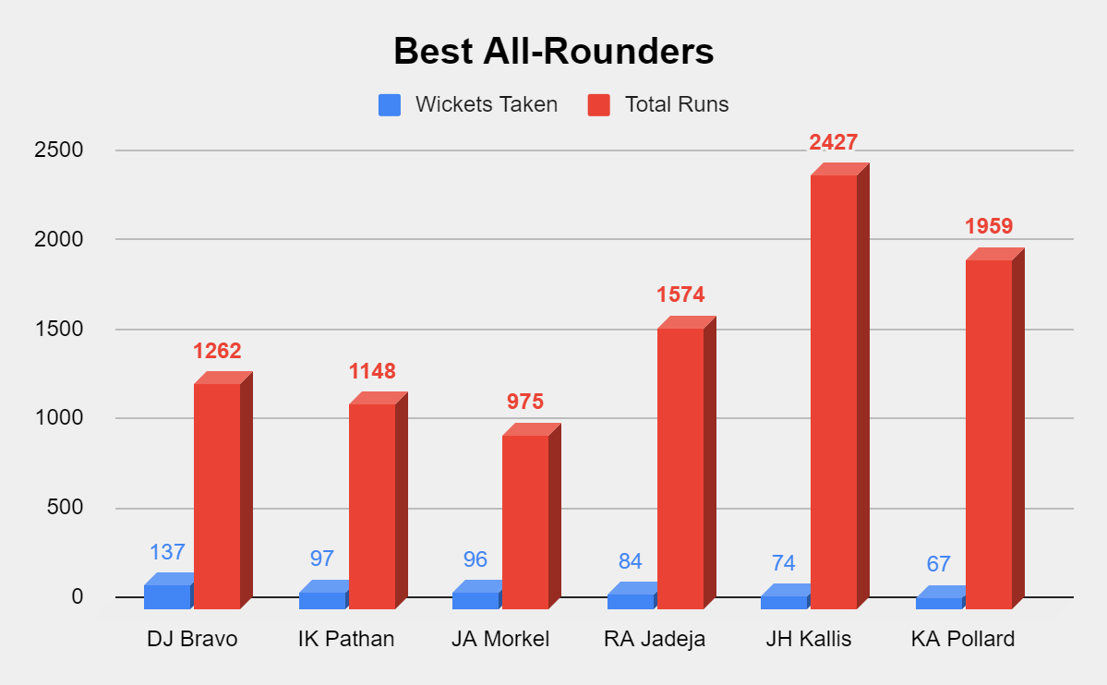
Player Recommendation
(All-Rounders)
Best all-rounders in the business.
They have the runs above 900 and wickets above 60

Slide 13

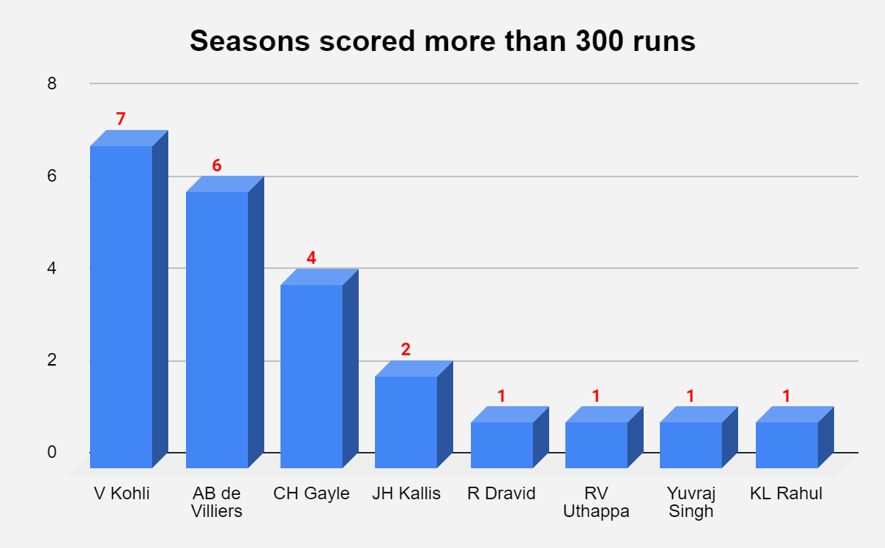
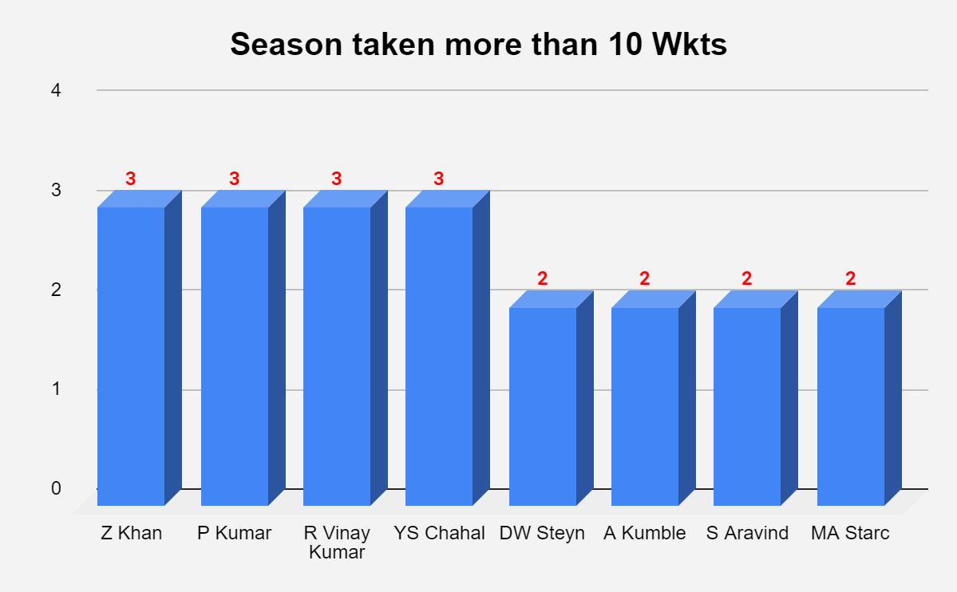
Batsmen to be retained :
V Kohli, AB Devilers & C Gayle
Reason :
Scored more than 300 runs in >=4 seasons
Bowler to be retained :
Z Khan, P Kumar, R Vinay Kumar, YS Chahal
Reason :
Taken more than 10 wickets in >=3 seasons

Slide 14
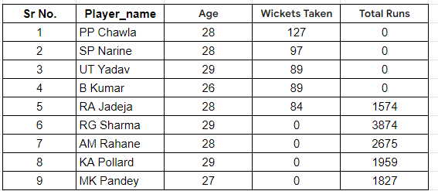
Players to watch out for:
There are 9 such players who should be attempted to be bought by RCB
Reason:
All are young players <30 years of age
Batsmen have scored more than 1500 runs
Bowlers have taken more than 80 wickets

Slide 15
THANK YOU

